Slide 1
SOLID Principles
A Field Guide to Software Engineering
Brett Carroll

Slide 2
About me – Brett Carroll
Software Developer for 7 years.
Worked on 5 different teams
Worked in Agile/Waterfall
Worked on ASM to XML
Cares about Software Engineering.
Three dogs
Dallas Native
Hobbies:
Electronics
Movies
Reading
Outside (where the bears are)

Slide 3
Agenda
Before SOLID – brief explanation OOP principals
Abstraction, Encapsulation and Polymorphism
SOLID
Formal Definition – for those who want concise, dense information.
Practical Definition – to start your mental model.
Example – for the visually inclined and concrete-model lovers
Motivation ☺
Ask questions!
Interrupt me!
Correct me!
Be prepared for some repetition.
repetition. repetition. repetition. repetition. repetition. repetition. repetition. repetition. repetition.

Slide 4
Object oriented Programming primer - ABSTRACTION
Object? Instance of a Class. A thing.
Object Oriented Programming? Abstract Data Type with Inheritance and Polymorphism.
Abstraction?
“Removing physical, spatial or temporal details or attributes in the study of objects or systems in order to more closely attend to other details of interest.
“Concept-objects which are created by keeping common features or attributes to various concrete objects. Factorization.”
Modeling real-world analog processes, objects or systems into digital analog automated processes. Getting sand/lightning to do what we want it to.
Example
Designing a Car.

Slide 5
Object oriented Programming primer- Encapsulation
Encapsulation?
Restrict Direct access to some of the objects components [information hiding]
Bundling data with methods [without hiding it].
Implementing an abstraction
Car example:
Gas Pedal/Steering Wheel

Slide 6
Object oriented programming primer - polymorphism
Polymorphism?
Single interface or symbol to represent multiple different types
Ad hoc/ Subtyping? Different implementations for different languages.
Parametric? Generics. new List<Type>();
Example
IAnimal => Speak{};
Dog : IAnimal => Speak{“bark”} Cat : IAnimal => Speak{“meow”} Dog.Speak “woof” Cat.Speak “meow”

Slide 7
SOLID
Arranged by Robert Martin – 2000 (Not his only principles)
Coined by Michael Feathers
Acronym of Acronyms
“Five principles intended to make software designs more understandable, flexible and maintainable” – Wikipedia, “SOLID”
The internet has consensus that this is true. -- Google
Keep in mind examples of where you have seen this work/ fail.

Slide 8
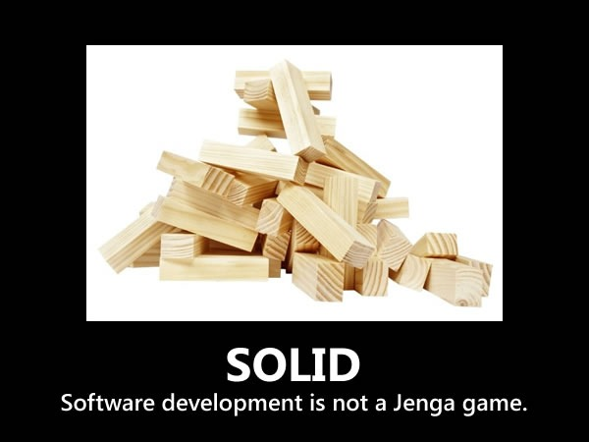

Slide 9
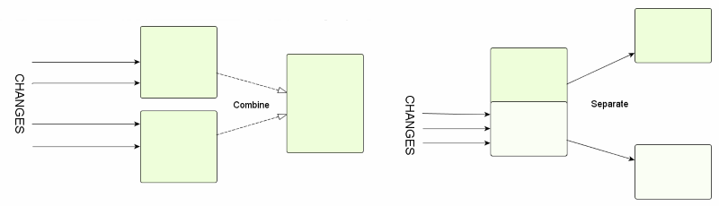
Srp - Single responsibility Principle
“A class should have one, and only one, reason to change.” – Robert Martin
WUT?

Slide 10
Srp – Practical definition
“Gather together the things that change for the same reasons. Separate those things that change for different reasons.” – Robert Martin
Original definition says class – Is it limited to classes?
Original definition says reason – What is a reason?
Original definition says change – Is a bug a change? How about a feature?
What if I don’t follow this rule?
Should I guess when to use this rule?

Slide 11
Srp – Simple Example
public class Printer {
public void Print (File input) { var formattedText = Format(input.Text); SendToPrinter(formattedText); }
public string Format(string text)…
public void SendToPrinter(string text)…
}
public class FilePrinter { public void Print(File input) { var formatter = new TextFormatter(); var formattedText = formatter.BoldFormat(input.Text); var printer = new DotMatrixPrinter(); printer.Print(formattedText); } }
public class TextFormatter { public string BoldFormat(string text)… … }
public class DotMatrixPrinter : IPrinter { public string Print(string text)… … }

Slide 12
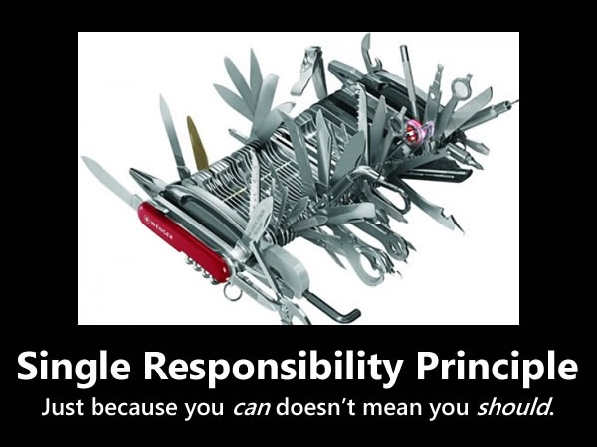

Slide 13
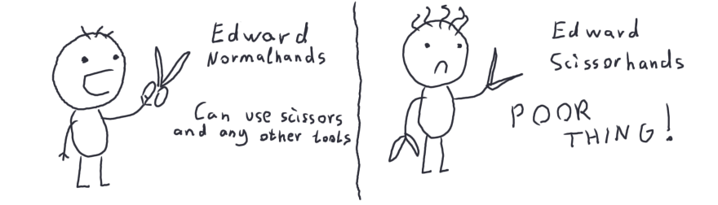
Ocp – Open closed principle
“You should be able to extend a classes behavior, without modifying it.” – Robert Martin
WUT?
https://dev.to/satansdeer/openclosed-principle-86a

Slide 14
Ocp – Practical Definition
“… software entities… should be open for extension, but closed for modification” – Bertrand Meyer
“Working code should only be written once.” – Me & some XPers probably
Can I fix bugs?
What if the requirements change?
What if new algorithms are invented?
What if I don’t do this?
Should I guess when to use this rule?

Slide 15
Ocp – simple example
public class TextFormatter { public string Format(string text, int type) { switch(type) { case 0: … // format bold … } } … }
public class FilePrinter { public void Print(File file) { var formatter = new TextFormatter(); var newText = formatter.Format(file.Text, 0); SendToPrinter(newText); } }
public interface ITextFormat { string Format(string text); }
public class BoldFormatter : ITextFormat { public string Format(string text); } public class FilePrinter { public void Print(File file) { var formatter = new BoldFormatter(); var newText =formatter.Format(file.Text); SendToPrinter(newText); } }

Slide 16
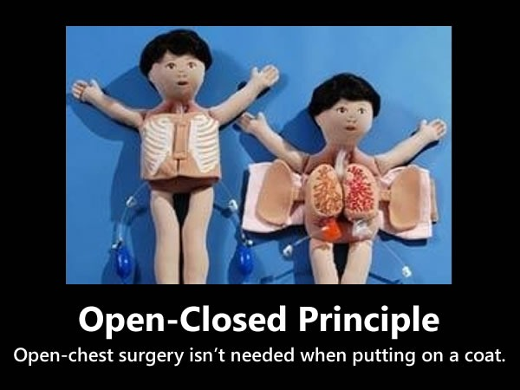

Slide 17
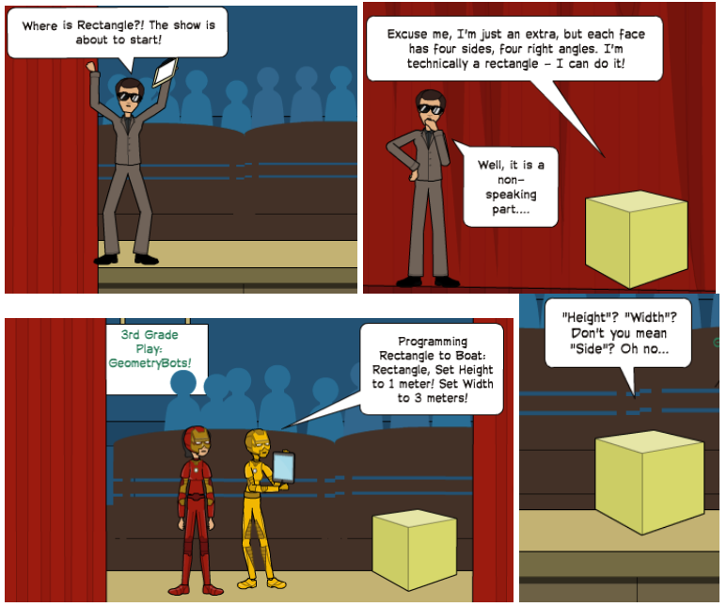
LSp – LisKov Substitution principle
“Let f(x) be a property provable about objects x of type T. Then g(y) should be true for objects y of type S where S is a subtype of T.” – Barbara Liskov
“Derived classes must be substitutable for their base classes.” – Robert Martin
WUT?
https://www.greatersum.com/solid-series-liskov-substitution-principle/

Slide 18
LSp – Practical Definition
“… don’t make your clients care what concrete class is in use” – Vadim Samokhin, “Liskov Substitution Principle”, Hackernoon
“Functions that use pointers of references to base classes must be able to use objects of derived classes without knowing it.” – Robert Martin
What if the subclasses don’t do the same thing?
What if I substitute a class and use a different method instead?
What if I do get the wrong abstraction?
How are things coupled?

Slide 19
LSp – Simple example
public class X : T { public void f() {…} }
public class Y : S { public void g() {…} } public abstract class S : T {…}
public abstract class T { void f(); void g(); }
public class Program { public void func1() { var tType = new X(); tType.f(); }
public void func2() { var sType = new Y(); sType.g(); } }

Slide 20
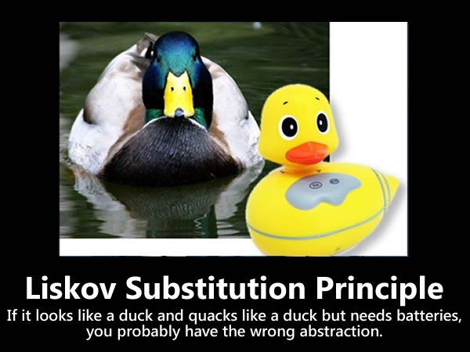

Slide 21
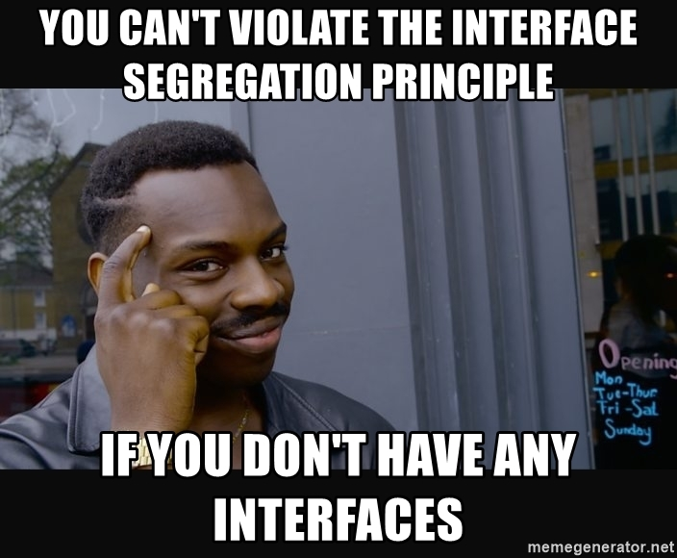
ISp – Interface segregation principle
“Make fine grained interfaces that are client specific” – Robert Martin

Slide 22
ISp – Practical definition
“ISP splits interfaces that are very large into smaller and more specific ones so that clients will only have to know about the methods that are of interest to them.” – Wikipedia
“… don’t ponder on whether your code violates [ISP], think about whether your abstractions are correct.” – Vadim Samokhin, “Interface Segregation Principle”, Hackernoon
I.E.: Get gud n00b.
So all you have to do is make the correct abstractions. Simple!
Why is this important?
What if we had only one interface for all classes?
What if we had no interfaces?

Slide 23
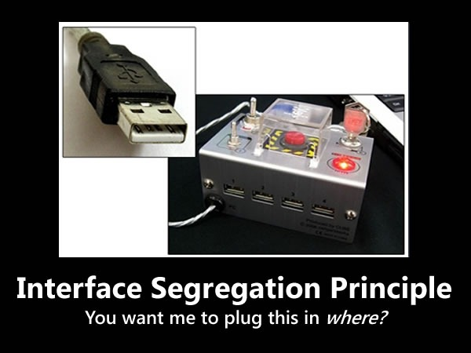

Slide 24
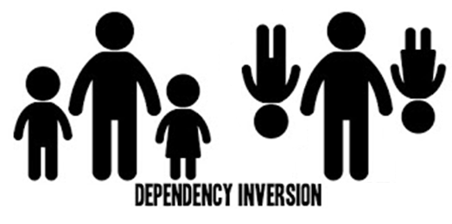
DIp – Dependency inversion principle
“Depend on abstractions, not on concretions.” – ReSharper Robert Martin

Slide 25
DIp – Practical Definition
“Identify and abstract-out your dependencies.” – Me
Dependency Inversion != Dependency Injection
Dependency Injection results from Inversion.
What is a dependency? (new is glue)
What if my algorithm changes?
What are the practical applications?

Slide 26
DIp – Simple example
public class FilePrinter { public void Print(File file) { var formatter = new BoldFormatter(); var text =formatter.Format(file.Text); var printer = new DotMatrixPrinter(); printer.Print(text); } }
public class OutputText { public bool Print(string text, ITextFormat format, IPrinter printer) { return printer.Print(formatter.Format(text)); } }
public class FilePrinter { private FIle file = new File(); public void PrintBoldDotMatrix(OutputText output) { output.Print(text, new BoldFormat(), new DotMatrixPrinter()); } }

Slide 27
DIp – Test example
[Test Class] public class OutputTextTests() { [Test Method] public class OutputText_Print_Success() { // Arrange var format = new TestFormat(); var printer = new TestPrinter(); var text = “TestText”; var output = new OutputText(); var expected = true; // Act var actual = output.Print(text, format, printer)
// Assert Assert.AreEqual(expected, actual); } }

Slide 28
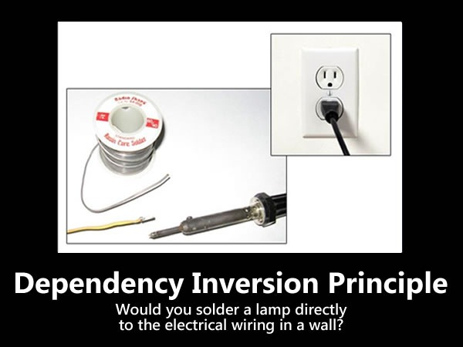

Slide 29
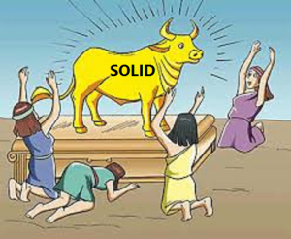
Fin
Q&A
https://jamesmccaffrey.wordpress.com/2016/08/24/the-solid-design-principles-absolute-nonsense/

Slide 30
Resources TO get you started
Agile Principles, Patterns, and Practices Robert Martin, Prentice Hall 2006 Chapters concerning SOLID are free at: http://butunclebob.com/ArticleS.UncleBob.PrinciplesOfOod
“You think you understand the Single Responsibility Principle” Series, James Ellis-Jones 2017, Hackernoon https://hackernoon.com/you-dont-understand-the-single-responsibility-principle-abfdd005b137
“The SOLID Principles, Explained with Motivational Posters.” – Joey deVilla https://blogs.msdn.microsoft.com/cdndevs/2009/07/15/the-solid-principles-explained-with-motivational-posters/

